Slide 1
Principles and Culture of Data Science
CRTP Fall Term, Week 2
Matt Engelhard, Duke Biostatistics & Bioinformatics

Slide 2
What are Machine Learning and Data Science?
Increasing Hype
“cognitive computing”
“artificial intelligence”
“predictive analytics”
“curve fitting”
“better stepwise regression”
“statistics for programmers”
Notes:
The topic of a thousand Medium posts
(briefly describe the origin of each term, from most to least flattering)

Slide 3
Q: What is Machine Learning?
Notes:
3 ways to answer this.
1: define it: we’ll start here
2: show it: during this course. But we’ll also take a look at some defining characteristics

Slide 4
Q: What is Machine Learning?
“ML is an algorithmic field that blends ideas from statistics, computer science and many other disciplines to design algorithms that process data, make predictions and help make decisions” – M. I. Jordan
Notes:
A definition, from MI Jordan at Berkeley (arguably one of the greatest ML researchers of all time):
Algorithmic – we’re pragmatic, crunching data
Interdisciplinary – we’re pulling ideas from a variety of fields
Predictions and decisions – focused on acting from data more than understanding how it was generated (i.e. where it came from)

Slide 5
Notes:
Both fields:
are based in math and probability
fit mathematical models to data
But, ML practitioners tend to:
embrace complex models with fewer theoretical guaranatees
care about predictions instead of model parameters

Slide 6
Parts of the Elephant
Part 1: Big Data
Notes:
Play both sides here

Slide 7
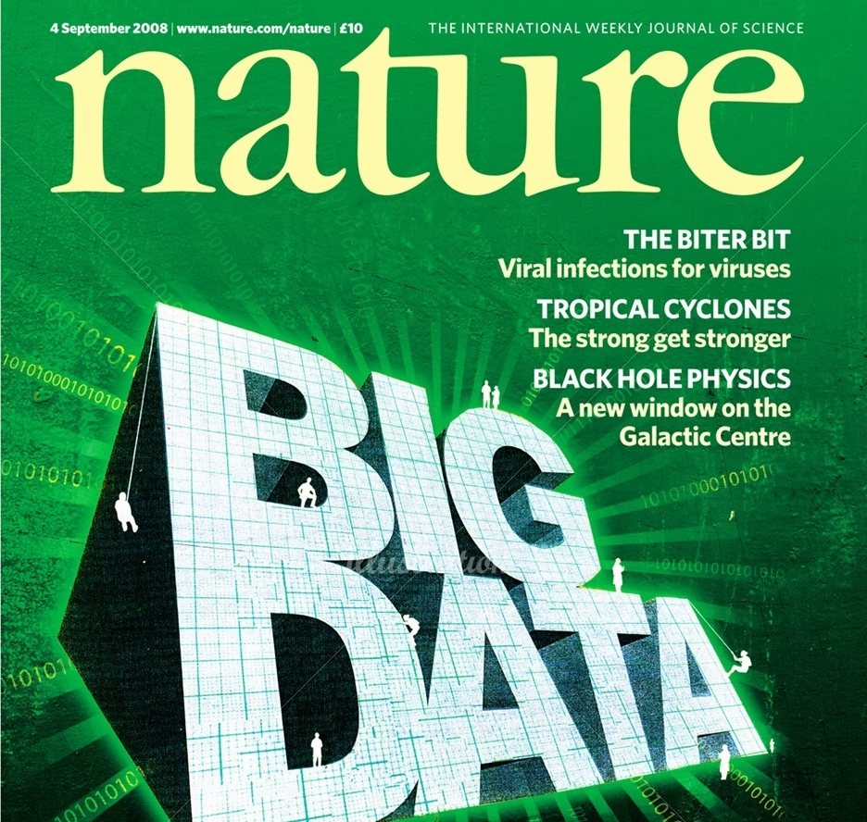
Notes:
Big data is everywhere!
We’re in the information age!
Data is the new electricity!

Slide 8
Notes:
Not just Google and Amazon…
EHR
Wearables
Transcribed Zoom calls?
We have an obligation to make sense of these data!

Slide 9
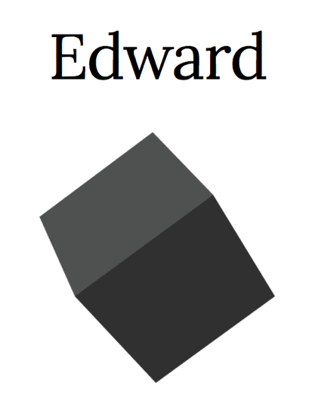
Hardware and computational platforms for big data and deep learning
Notes:
We’ve got the resources to crunch the numbers
Computational power
Big machine learning libraries

Slide 10
Neural networks thrive on big data
Inception v3 Convolutional Neural Network
Notes:
We’ve got the models to take advantage of it!
CNNs didn’t work well before big data, and now they’re state of the art

Slide 11
Big Data
Long Data
Large N
A clinical study with 50k participants
A speech database with 10M short recordings
Wide Data
Large P
A mHealth study with 6 months of wearables data in 20 participants
10 minutes of raw fMRI data in 8 participants
Notes:
We’ve even got two different kinds of big, which complement one another
P vs N

Slide 12
Parts of the Elephant
Part 2: Prediction over Explanation
Notes:
Play both sides here

Slide 13
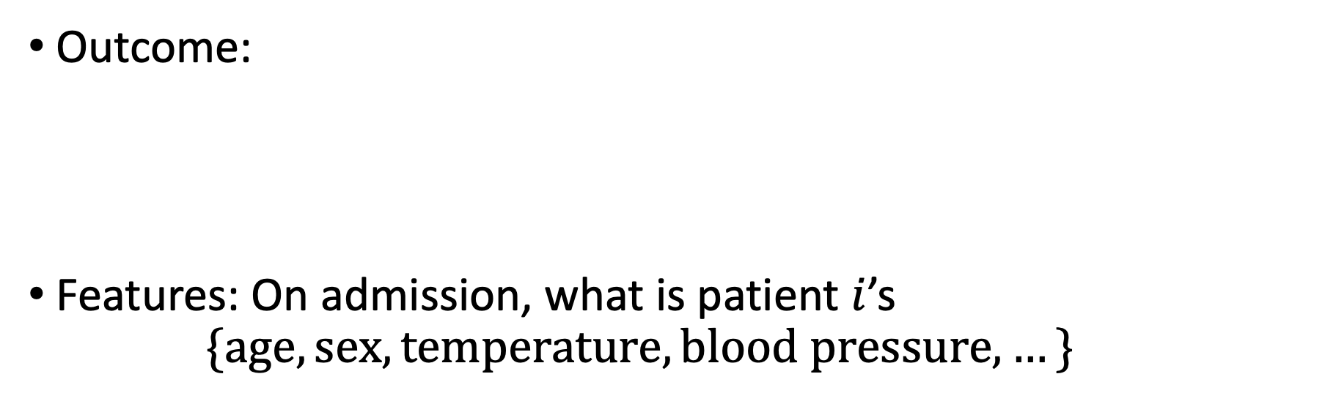
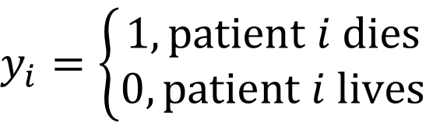
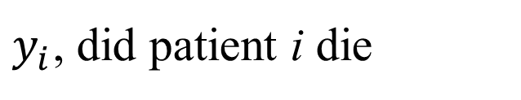
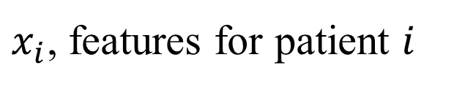
Previous Example: ICU Mortality Prediction
Outcome:
Features: On admission, what is patient $i$’s
$$\{age, sex, temperature,blood pressure,…\}$$
$$y_{i}=\left\{\begin{aligned}1, patient i dies \\ 0, patient i lives\end{aligned}\right.$$
$y_{i}$, did patient i die
$x_{i}$, features for patient $i$
Notes:
How were you taught to evaluate this model in a statistics class?
Fit the model on the whole dataset
Apply hypothesis tests (t-tests) to parameters
How have I been telling you to evaluate it?

Slide 14
What’s our goal?
Answer 1:
Determine who’s at highest risk of death so we can plan or manage resources accordingly
Prediction
Answer 2:
Identify predictors of mortality to further scientific understanding and design interventions
Interpretation/
Understanding
Notes:
Answer 1: diagnostics. Admissions prediction. Recommendation systems. Etc.
Answer 2: note that if we have this perspective, must recognize that we are not doing causal inference

Slide 15
What’s our goal?
DS evaluation:
Determine whether the model performs well on new data
A1: Prediction
A2: Interpretation
Explanatory Approach:
Evaluate model parameters, e.g. by null-hypothesis testing
Notes:
Stats: a million goodness of fit tests – confusing!
Who needs them?
We don’t care how good it fits
We just care how good we predict stuff

Slide 16
What’s our goal?
A1: Prediction
Black box may be OK as long as we’re sure it works well.
A2: Interpretation
We need to look inside the box.
Notes:
Describe the black box idea: features in, prediction out
Whether it’s OK depends on your perspective
If appropriate, point out that predictors selected are often arbitrary
Remember, none of this is causal.
Glass box:
- understand how the model works
Make sure it’s not doing something it shouldn’t be
Still doesn’t really give you scientific insight.

Slide 17
Parts of the Elephant
Part 3: Competitions, Benchmarks, and Code Sharing
Notes:
Play both sides here

Slide 18
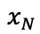
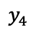
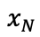
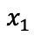
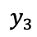
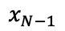
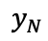
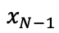
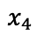
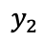
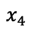
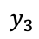
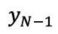
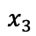
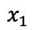
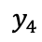
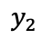
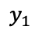
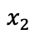
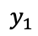
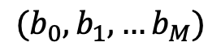
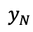
Standardized Evaluation Strategy
Goal: estimate performance on real-world data
“generalization”
“out-of-sample”
$$x_{1}$$
$$y_{1}$$
$$x_{2}$$
$$y_{2}$$
$$x_{3}$$
$$y_{3}$$
$$x_{4}$$
$$y_{4}$$
$$x_{N−1}$$
$$x_{N}$$
$$y_{N}$$
Training Set
$$x_{1}$$
$$y_{1}$$
$$x_{2}$$
$$y_{2}$$
$$x_{3}$$
$$y_{3}$$
$$x_{4}$$
$$y_{4}$$
$$x_{N−1}$$
$$y_{N−1}$$
$$x_{N}$$
$$y_{N}$$
$({b_{0},b}_{1},…b_{M})$
Test Set
Estimate Real-World Performance
Notes:
We set the problem up the same way every time (why?)
Good for estimating real-world performance
Also good for comparing teams
“Turn in your model…”

Slide 19
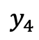
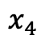
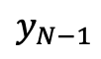
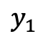
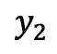
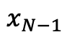
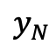
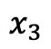
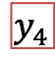
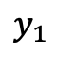
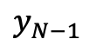
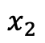
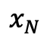
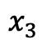
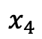
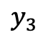
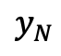
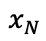
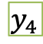
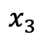
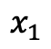
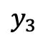














Standardized Evaluation Strategy
Refine Model
$$x_{1}$$
$$y_{1}$$
$$x_{1}$$
$$y_{1}$$
$$x_{2}$$
$$y_{2}$$
$$x_{2}$$
$$y_{2}$$
$$x_{3}$$
$$y_{3}$$
$$x_{3}$$
$$y_{3}$$
$$x_{4}$$
$$y_{4}$$
$$x_{4}$$
$$y_{4}$$
$$x_{1}$$
$$y_{1}$$
$$x_{N−1}$$
$$x_{2}$$
$$y_{2}$$
$$x_{N−1}$$
$$y_{N−1}$$
$$x_{N}$$
$$y_{N}$$
$$x_{3}$$
$$y_{3}$$
$$x_{N}$$
$$y_{N}$$
Training Set
$$x_{4}$$
$$y_{4}$$
Test
$$x_{N−1}$$
$$y_{N−1}$$
$$x_{N}$$
$$y_{N}$$
$({b_{0},b}_{1},…b_{M})$
Validation
Estimate Performance on Validation Set
Final Performance Evaluation
Notes:
While we’re here, let’s go over it once more…
If we’re competing, it’s on that final performance evaluation

Slide 20
Pitfalls: Training, Validation, and Test
This can be more nuanced than it might seem, and is a common source of methodological errors!
Pitfall 1: Multiple data points from the same individual or source
Pitfall 2: Utilizing data from the test or validation set prior to “modeling”
feature selection using the whole dataset
other information “leaks”
Pitfall 3: Systematic differences between test, validation, and training sets
Notes:
Describe Pitfalls

Slide 21
Pitfalls: Training, Validation, and Test
This can be more nuanced than it might seem, and is a common source of methodological errors!
PITFALL 0: Repeatedly evaluating on the test set!
Pitfall 1: Multiple data points from the same individual or source
Pitfall 2: Utilizing data from the test or validation set prior to “modeling”
feature selection using the whole dataset
other information “leaks”
Pitfall 3: Systematic differences between test, validation, and training sets
Notes:
Essentially, multiple records from a single person is “clustered data”. If you split them across sets, you are still overfitting.
Need to assign these to the same split.
And PITFALL 0: Evaluating multiple times on the test set
Think of it like a randomization scheme, where it depends on the study design.

Slide 22
Standardized Evaluation Strategy
Usually the goal is to estimate how well the model will perform in the real world
But it’s also a good setup for competition…
Which model (& team) did best on the test set?
$$x_{1}$$
$$y_{1}$$
$$x_{2}$$
$$y_{2}$$
$$x_{3}$$
$$y_{3}$$
$$x_{4}$$
$$y_{4}$$
$$x_{N−1}$$
$$x_{N}$$
$$y_{N}$$
Training Set
$$x_{1}$$
$$y_{1}$$
$$x_{2}$$
$$y_{2}$$
$$x_{3}$$
$$y_{3}$$
$$x_{4}$$
$$y_{4}$$
$$x_{N−1}$$
$$y_{N−1}$$
$$x_{N}$$
$$y_{N}$$
$({b_{0},b}_{1},…b_{M})$
Test Set
Estimate Real-World Performance
Notes:
We set the problem up the same way every time (why?)
Good for estimating real-world performance
Also good for comparing teams
“Turn in your model…”

Slide 23
Notes:
So what do we do?
Create a huge dataset: millions of images and associatd labels

Slide 24


Notes:
A grand challenge: build the model that makes the best predictions on this huge dataset
Now, world: have at it!

Slide 25

Notes:
This is the formula for making performance get better year after year after year
Some competition occurs naturally from making these data available

Slide 26

Notes:
Other competition is deliberately encouraged through challenges and prizes

Slide 27

Notes:
This stuff makes the news because it’s not some esoteric benchmark
We’re building models that compete with each other, or real people, on tasks that billions of people care about – a LOT

Slide 28


Notes:
And if you want to compete, you MUST share your code
The precedent has been set, and is (generally) followed
As much as I don’t like facebook sometimes… they do (generally) respect the precedent

Slide 29

Notes:
THIS IS HAPPENING IN HEALTH TOO

Slide 30

Notes:
We’re behind but catching up
Still, some data sources missing – think EHR, wearables
What’s the grand challenge?
How do we promote competition?

